Slide 1
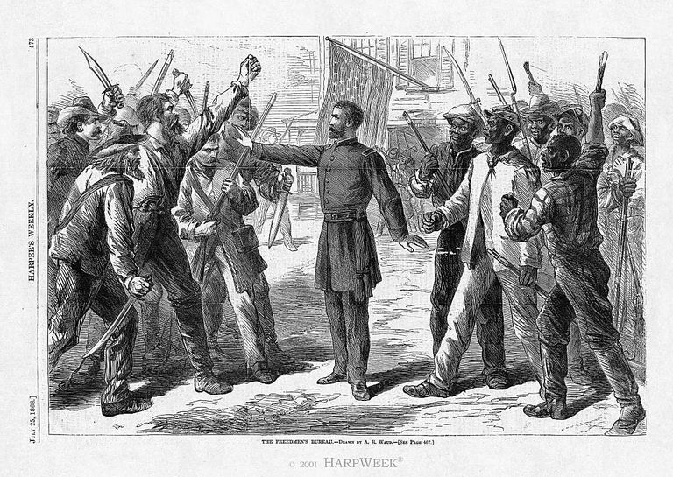
The Impact of the Freedmen’s Bureau
By: Mr. T.

Slide 2
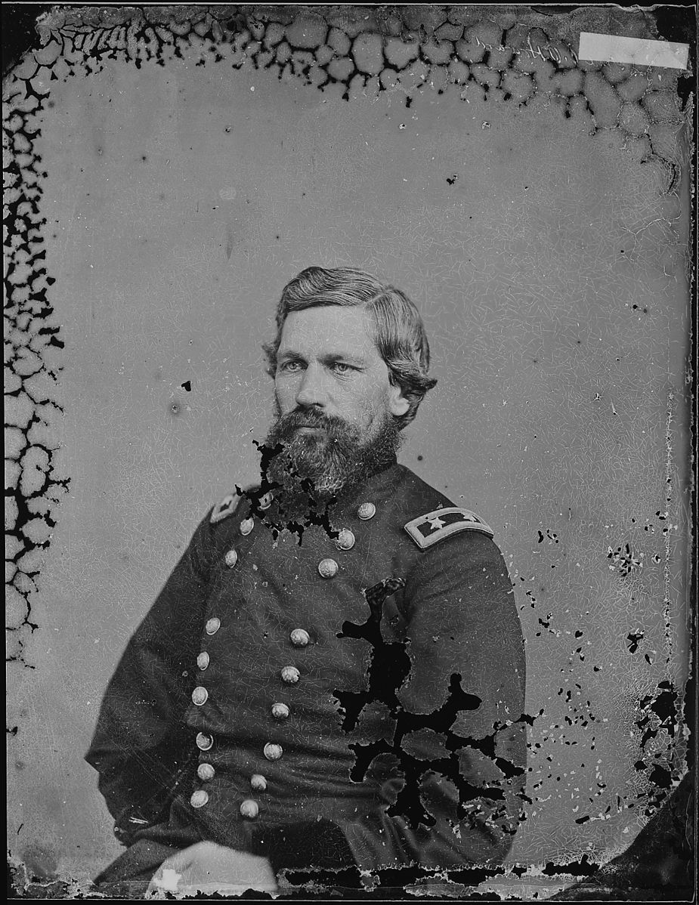
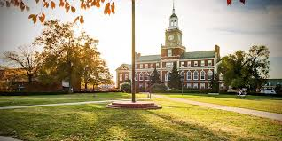
Structures of the Freedmen’s Bureau
Established in 1865 chartered by Pres. Lincoln
It only lasted until 1870 and at its peak it had less than 1,000 members to go around the entire south
Oliver O. Howard led the movement
Made it a priority to deliver food, health care, and education.
Cracked down on corruption and unfair treatment
Started the first Historically Black College (Howard University)
Notes:
This is one of the reasonsit failed. 1,000 members only

Slide 3
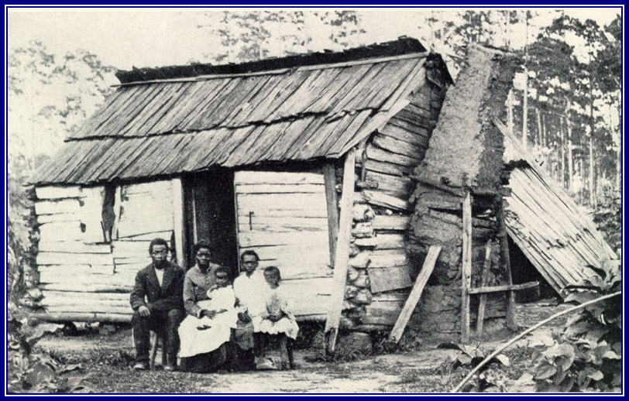
Freedmen’s Bureau -- What was it?
The Freedmen’s Bureau’s goal was to provide food, clothing, healthcare, and education for both black and white refugees in the South.
Goal: Bring equality and be social advocates
1.Reunite families that had been separated by slavery and war.
2.Negotiate fair labor contracts between former slaves and white landowners.
3.Helped represent African Americans in courts.
4. Smooth the transition from slavery to freedom
The Bureau also helped to:
Historical Significance: Established the precedent that black citizens had legal rights.

Slide 4
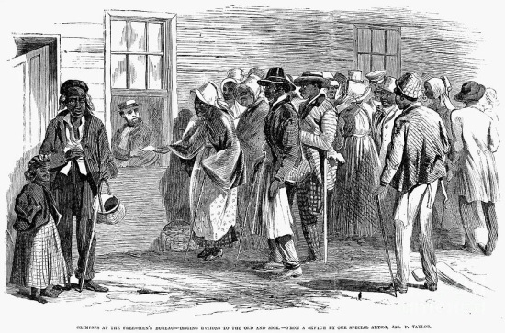
Freedmen’s bureau day to day
The bureau provided rations for the unemployed (including whites)

Slide 5
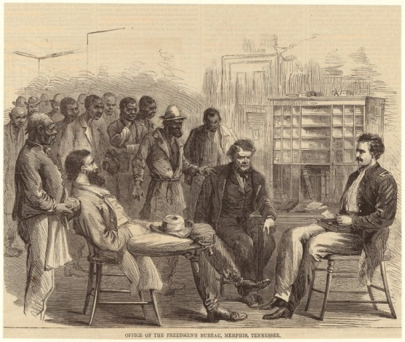
Freedmen’s Bureau Day to day Cont.
Regulating agreements with old masters and representing them in court

Slide 6
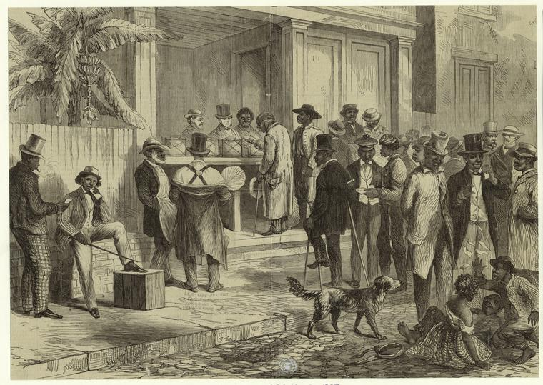
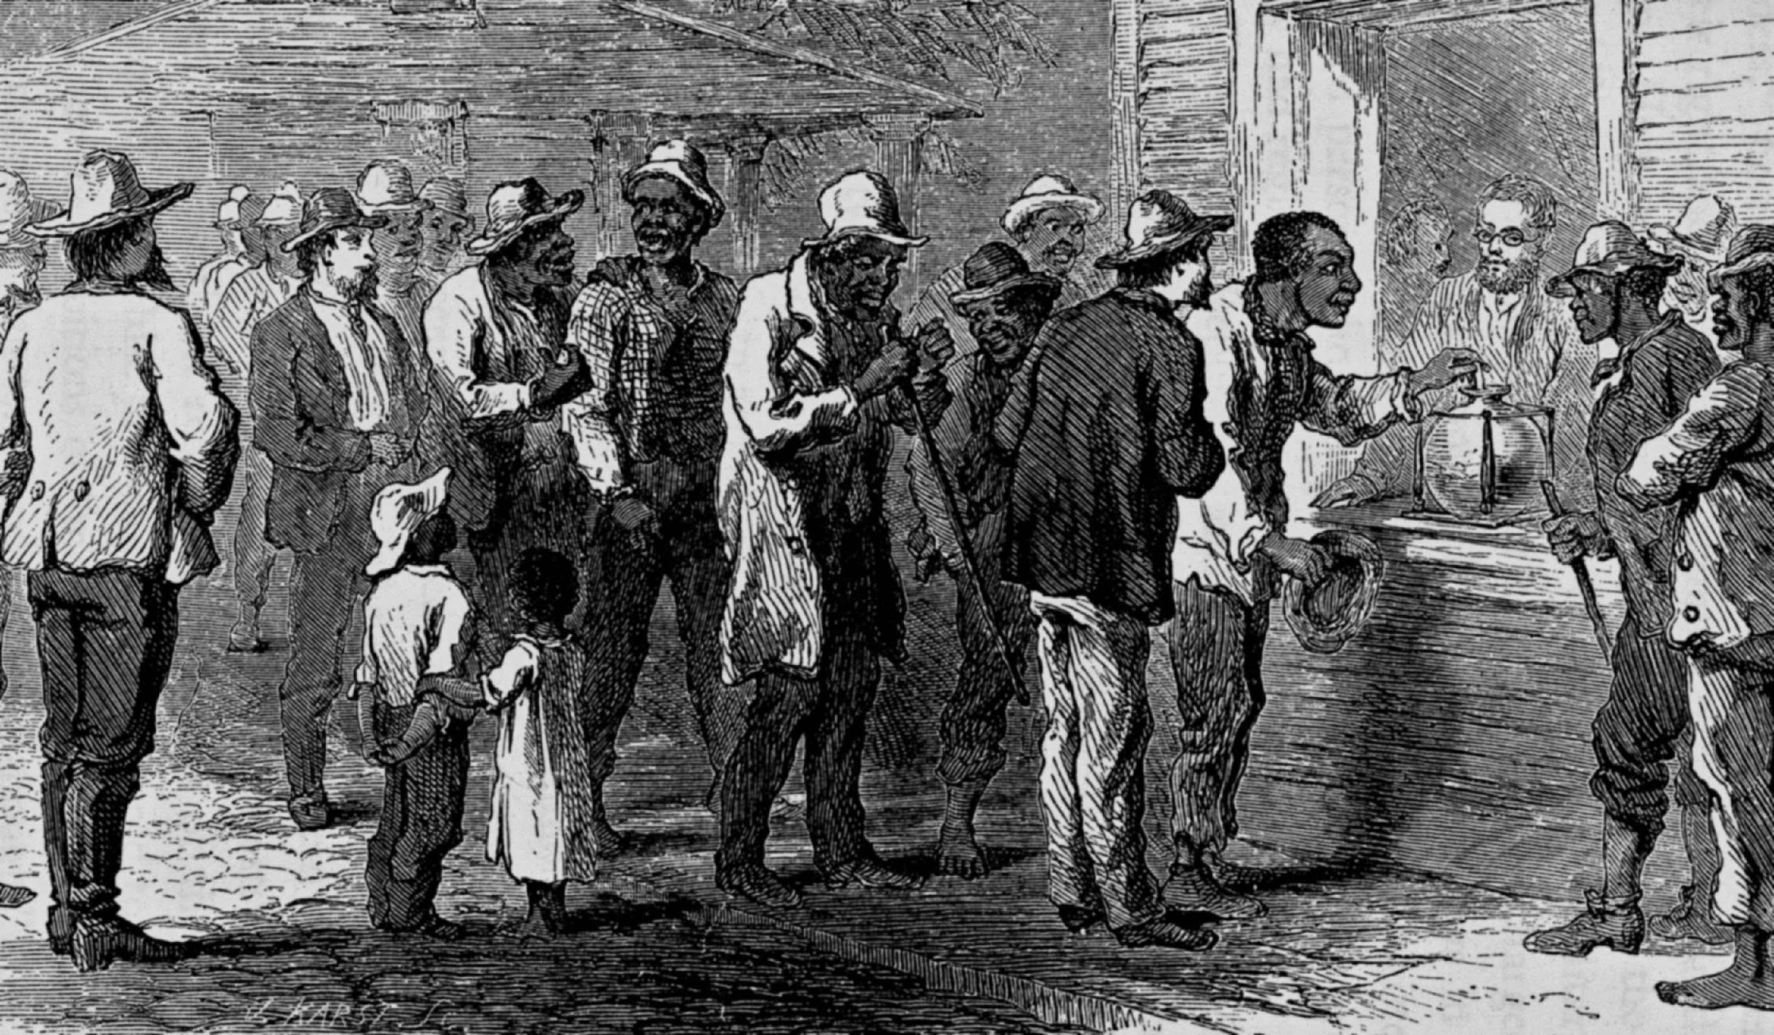
Overseeing the first elections

Slide 7
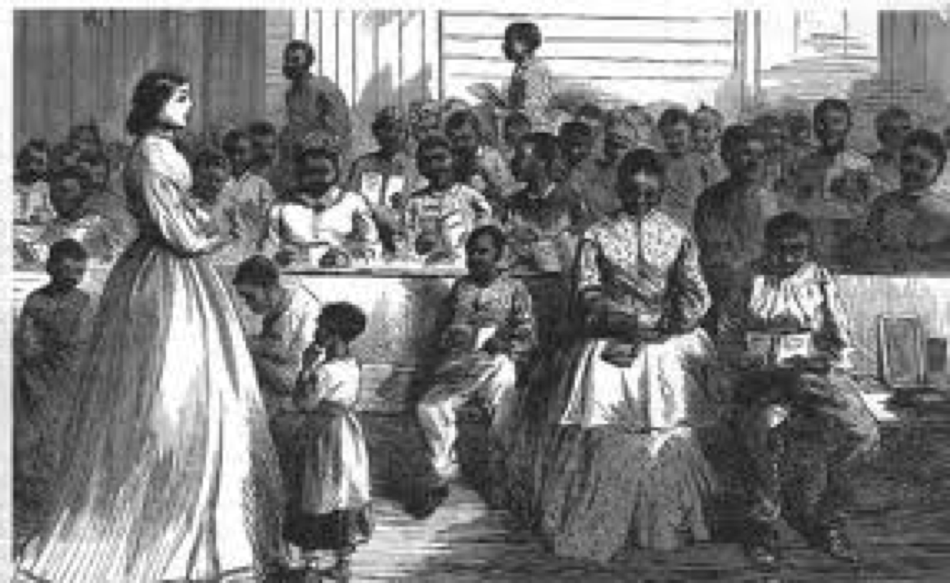
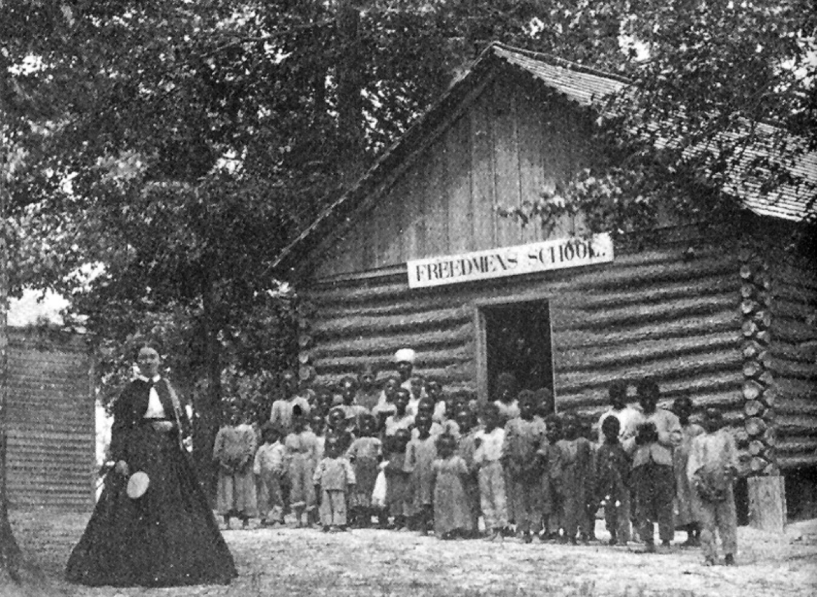
Freedmen’s Bureau and education
Education was one of the most important accomplishments of the Bureau
Education of freedmen/slaves were illegal prior to the War
Bureau used confiscated property such as buildings, books, materials, furnitures to be used for education
Provided transportation, room and board for teachers
Recruited many northerners to come educate freedmen
Spent over $5 million to set up schools for blacks
By 1870 there were over 1,000 schools for freedmen in the south with more than 90,000 enrolled
Type of Justice:
Distributive
Notes:
After the war, it became a great desire. But how do you start? White elites were against it and would not support it. How do you get books, desks, pencils all that good stuff?
Bureau worked on legislation that gave them power to seize confederate goods for the purpose of education
LAST POINT: They published their own books that taught 1) bootstraps philosophy 2) Bible verses on forgiveness 3)

Slide 8
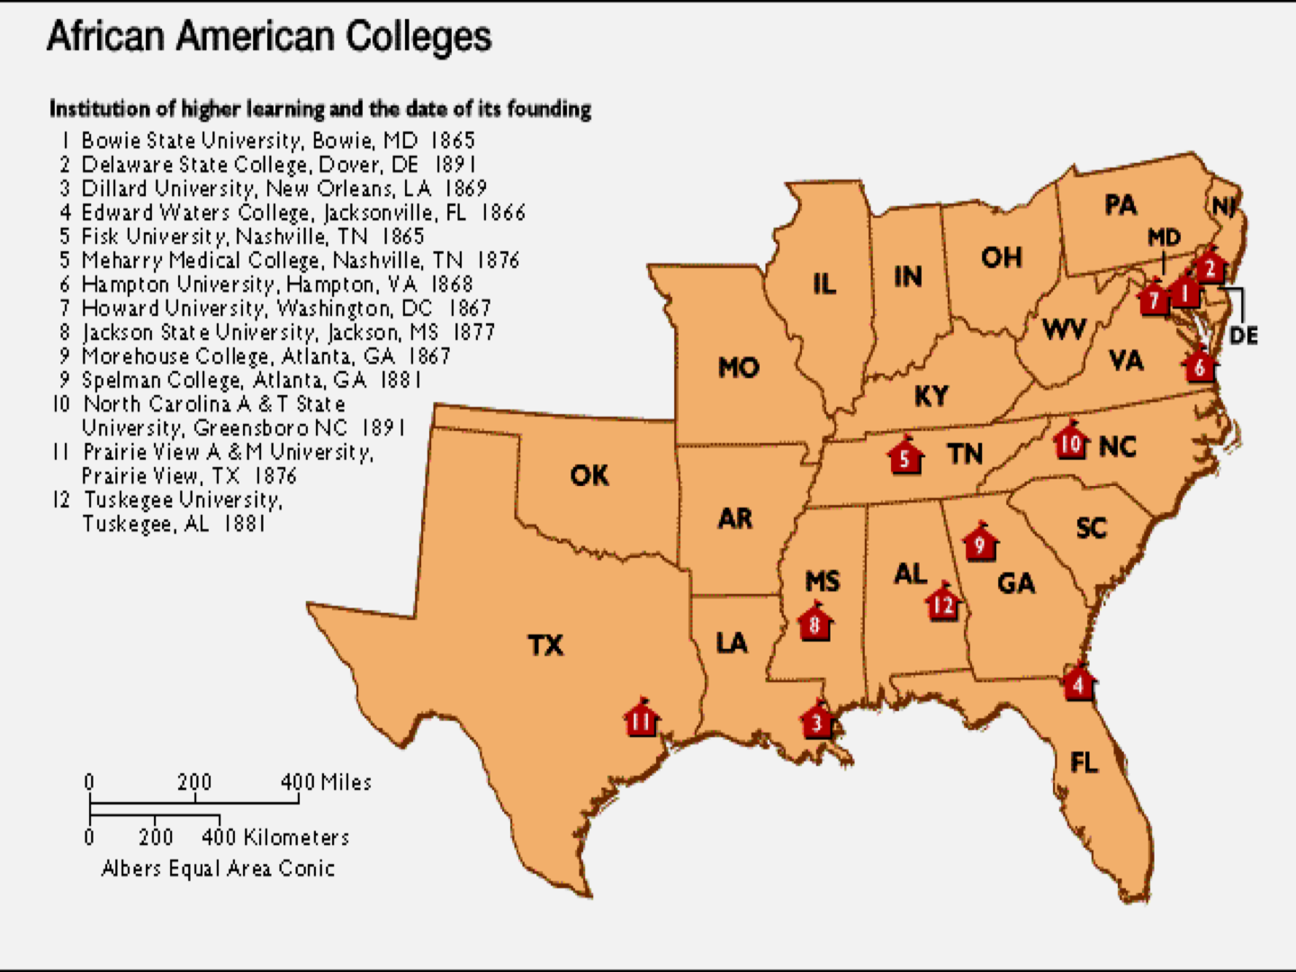
Freedmen’s Bureau and Education Cont.
The Bureau believed that educating adults as well as youth was critical so they moved to higher ed.
Freedmen’s bureau created the first Historically Black Colleges and University
They managed to create 25 colleges/universities between 1866 - 1872
Schools focused on: financial freedom, sustainability, taught uplift suasion
Legacy:
Today there are over 100 HBCs that are still seeking to empower the race

Slide 9
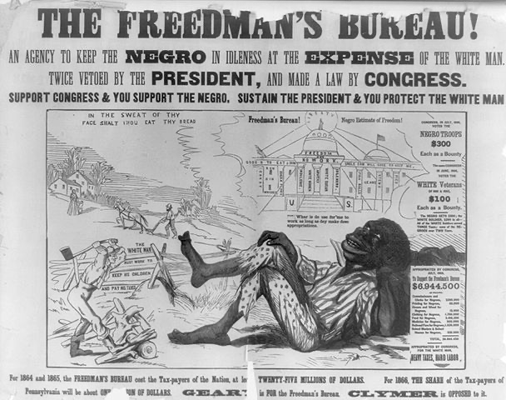
The view of the South on the Bureau

Slide 10
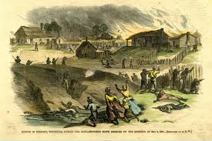
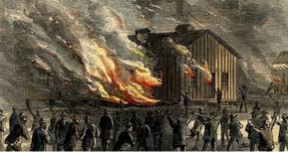
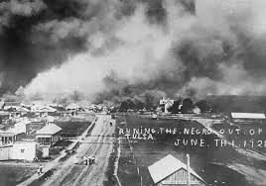
The downfall and its effects on education
Congress got rid of the Bureau in 1872 and the military left the south
Without the military and the bureau who protects the schools, churches….?
Who provides materials, resources, wages.
Notes:
Pressure from kkk
Pressure from white supremacy groups
As the south becomes like the old south, less support goes towards schools.

Slide 11
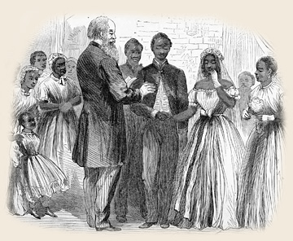
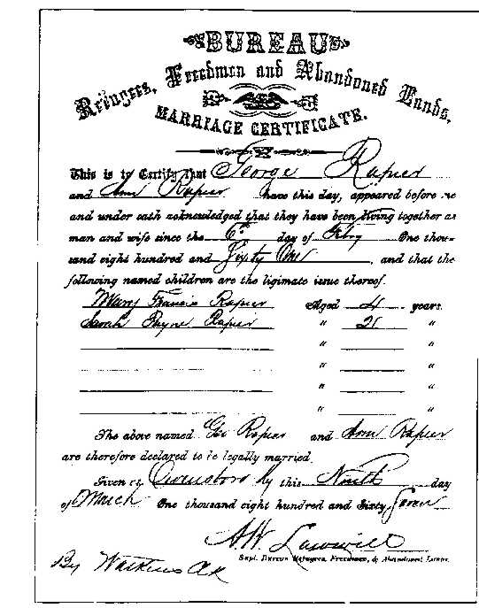
Churches
“...No Negro shall be permitted to preach, exhort, or otherwise declaim to congregation of colored people, without a special permission in writing from the president of the police jury…”

